Slide 1
CSS box model

Slide 2
CSS Selectors

Slide 3
CSS
Everything in CSS has a box around it, and understanding these boxes is key to being able to create layouts with CSS, or to align items with other items.
In CSS we broadly have two types of boxes — block boxes and inline boxes.

Slide 4
Block and inline boxes
Everything in CSS has a box around it, and understanding these boxes is key to being able to create layouts with CSS, or to align items with other items.
In CSS we broadly have two types of boxes — block boxes and inline boxes.

Slide 5
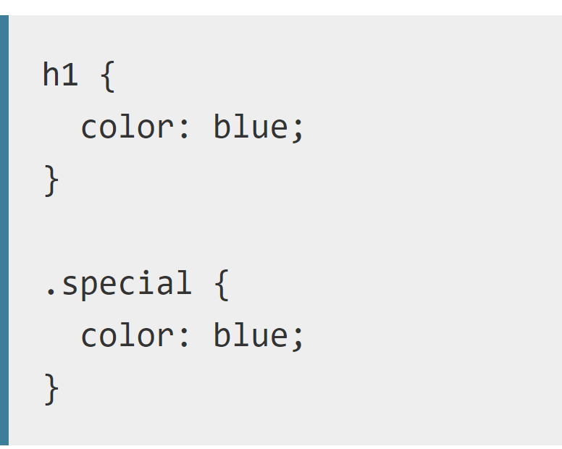
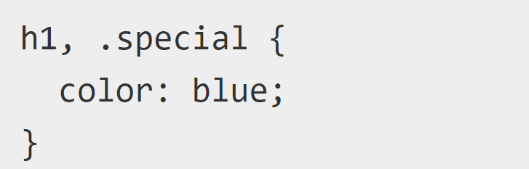
Selector Lists
If you have more than one thing which uses the same CSS then the individual selectors can be combined into a selector list so that the rule is applied to all of the individual selectors.
For example, if I have the same CSS for an h1 and also a class of .special, I could write this as two separate rules.
I could also combine these into a selector list, by adding a comma between them.

Slide 6
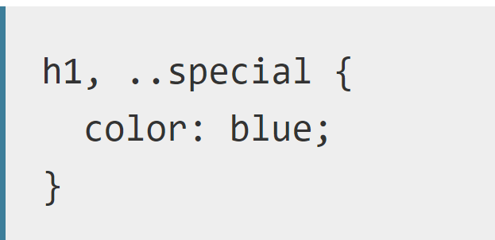
Selector Lists
When you group selectors in this way, if any selector is invalid the whole rule will be ignored.
In this example, the entire rule will be deemed invalid as the class special has an invalid class selector.

Slide 7
Types of Selectors

Slide 8


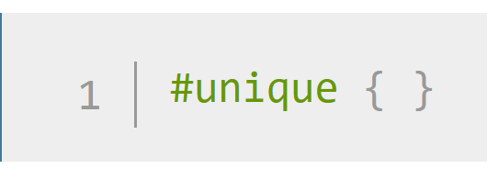
Type, class and ID selectors
This group includes selectors that target an HTML element such as an <h1>.
It also includes selectors which target a class
Or ID

Slide 9


Attribute selectors
This group of selectors gives you different ways to select elements based on the presence of a certain attribute on an element:
Or even make a selection based on the presence of an attribute with a particular value:

Slide 10


Pseudo-classes and pseudo-elements
A pseudo-class is a selector that selects elements that are in a specific state, e.g. they are the first element of their type, or they are being hovered over by the mouse pointer.
Pseudo-classes are keywords that start with a colon
Example: the :first-child pseudo-class selector — this will always target the first child element in the article
All pseudo-classes behave in this same kind of way. They target some bit of your document that is in a certain state, behaving as if you had added a class into your HTML

Slide 11

Pseudo-classes and pseudo-elements
Pseudo-elements behave in a similar way, however they act as if you had added a whole new HTML element into the markup, rather than applying a class to existing elements.
Pseudo-elements start with a double colon ::

Slide 12
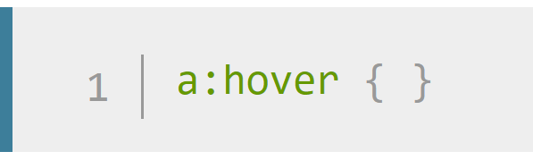

Pseudo-classes and pseudo-elements
This group of selectors includes pseudo-classes, which style certain states of an element.
The :hover pseudo-class for example selects an element only when it is being hovered over by the mouse pointer:
It also includes pseudo-elements, which select a certain part of an element rather than the element itself.
For example, ::first-line always selects the first line of text inside an element (a <p> in the below case), acting as if a <span> was wrapped around the first formatted line and then selected.

Slide 13

Combinators
The final group of selectors combine other selectors in order to target elements within our documents.
The following for example selects paragraphs that are direct children of <article> elements using the child combinator (>):

Slide 14
Selector Types

Slide 15
Type Selector
A type selector is sometimes referred to as a tag name selector or element selector, because it selects an HTML tag/element in your document

Slide 16
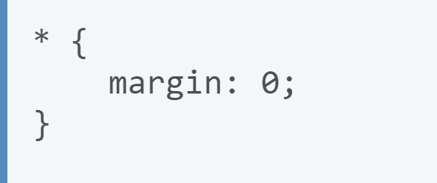
Universal Selector
The universal selector is indicated by an asterisk (*) and selects everything in the document.
In the following example we have used the universal selector to remove the margins on all elements.
This means that instead of the default styling added by the browser, which spaces out headings and paragraphs with margins, everything is close together and we can't see the different paragraphs easily.

Slide 17
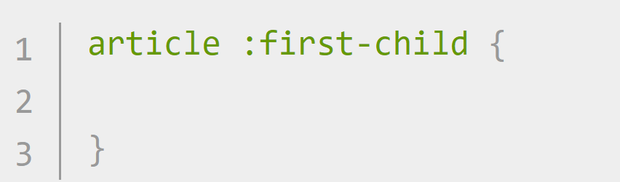
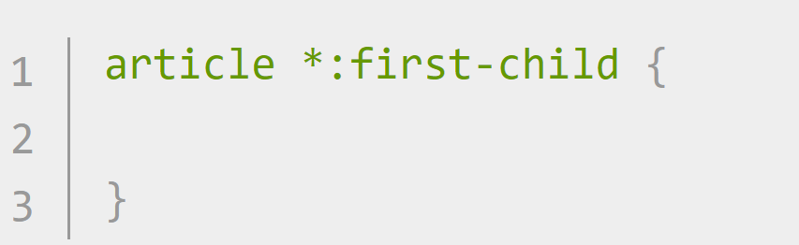
Universal Selector
if I wanted to select the first child of any <article> element, no matter what element it was, and make it bold, I could use the :first-child selector.
This could be confused however with article:first-child, which will select any <article> element that is the first child of another element.
To avoid this confusion we can add the universal selector to the :first-child selector, so it is obvious what the selector is doing. It is selecting any element which is the first-child of an <article> element:

Slide 18
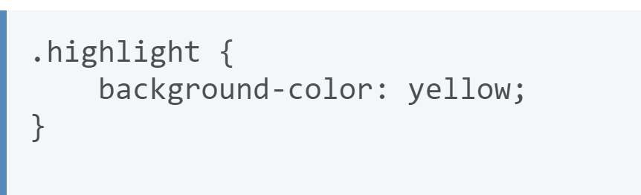
Class Selector
The class selector starts with a full stop (.) character and will select everything in the document with that class applied to it.

Slide 19
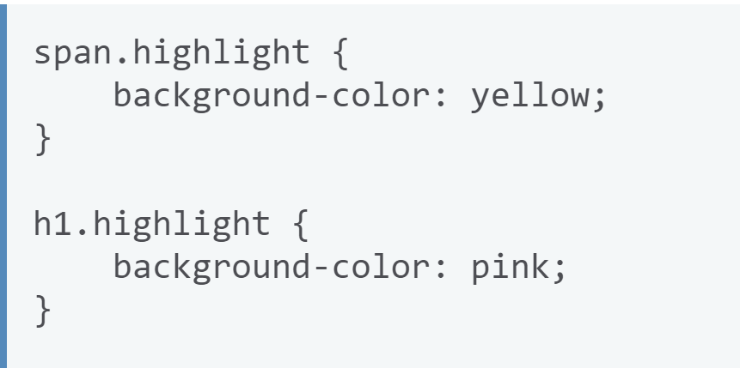
Class Selector
Targeting Classes on Particular Elements
You can create a selector that will target specific elements with the class applied.

Slide 20
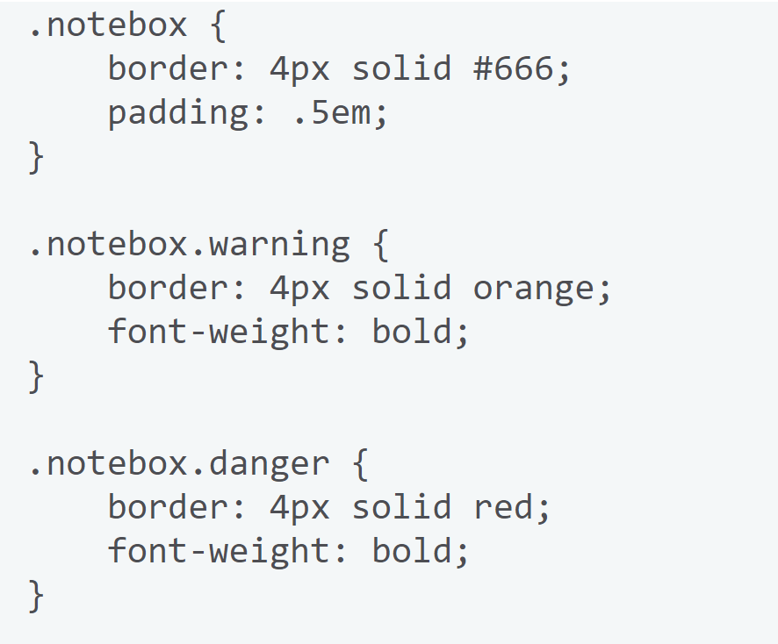
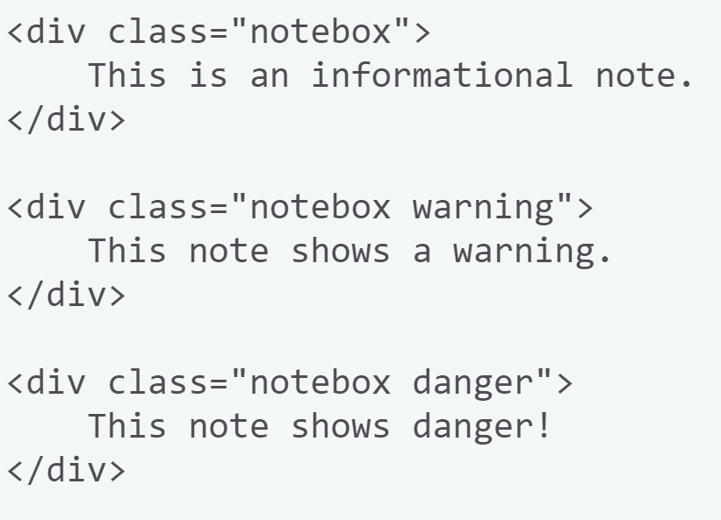
Class Selector
Target an element if it has more than one class applied
You can apply multiple classes to an element and target them individually, or only select the element when all of the classes in the selector are present.

Slide 21
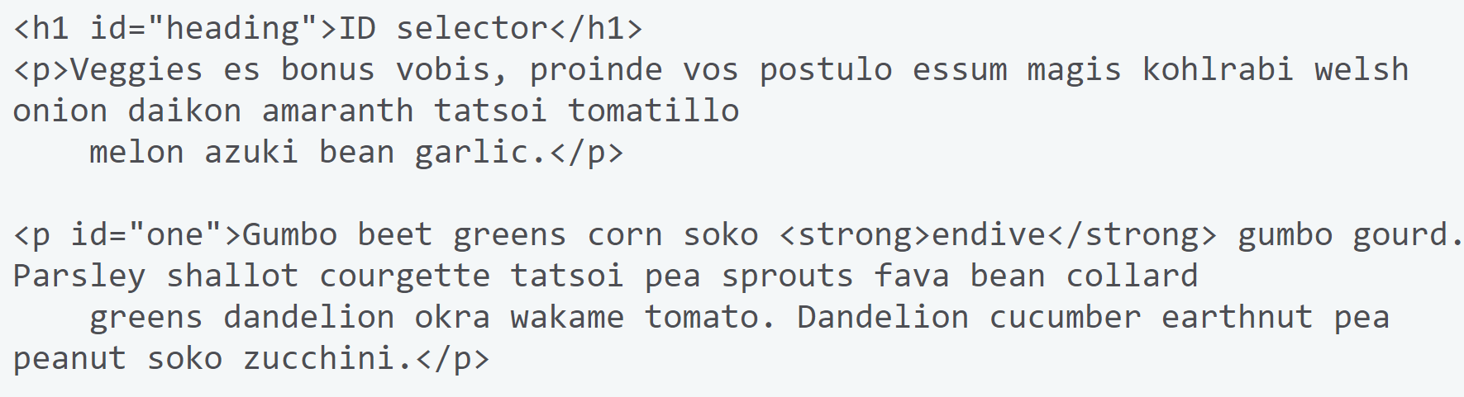
ID Selector
An ID selector begins with a # rather than a full stop character, but is basically used in the same way as a class selector.
An ID however can be used only once per document.
It can select an element that has the id set on it, and you can precede the ID with a type selector to only target the element if both the element and ID match.

Slide 22
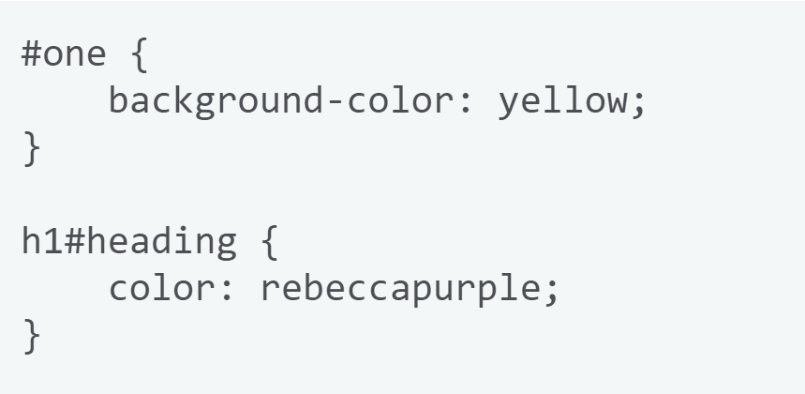
ID Selector

Slide 23
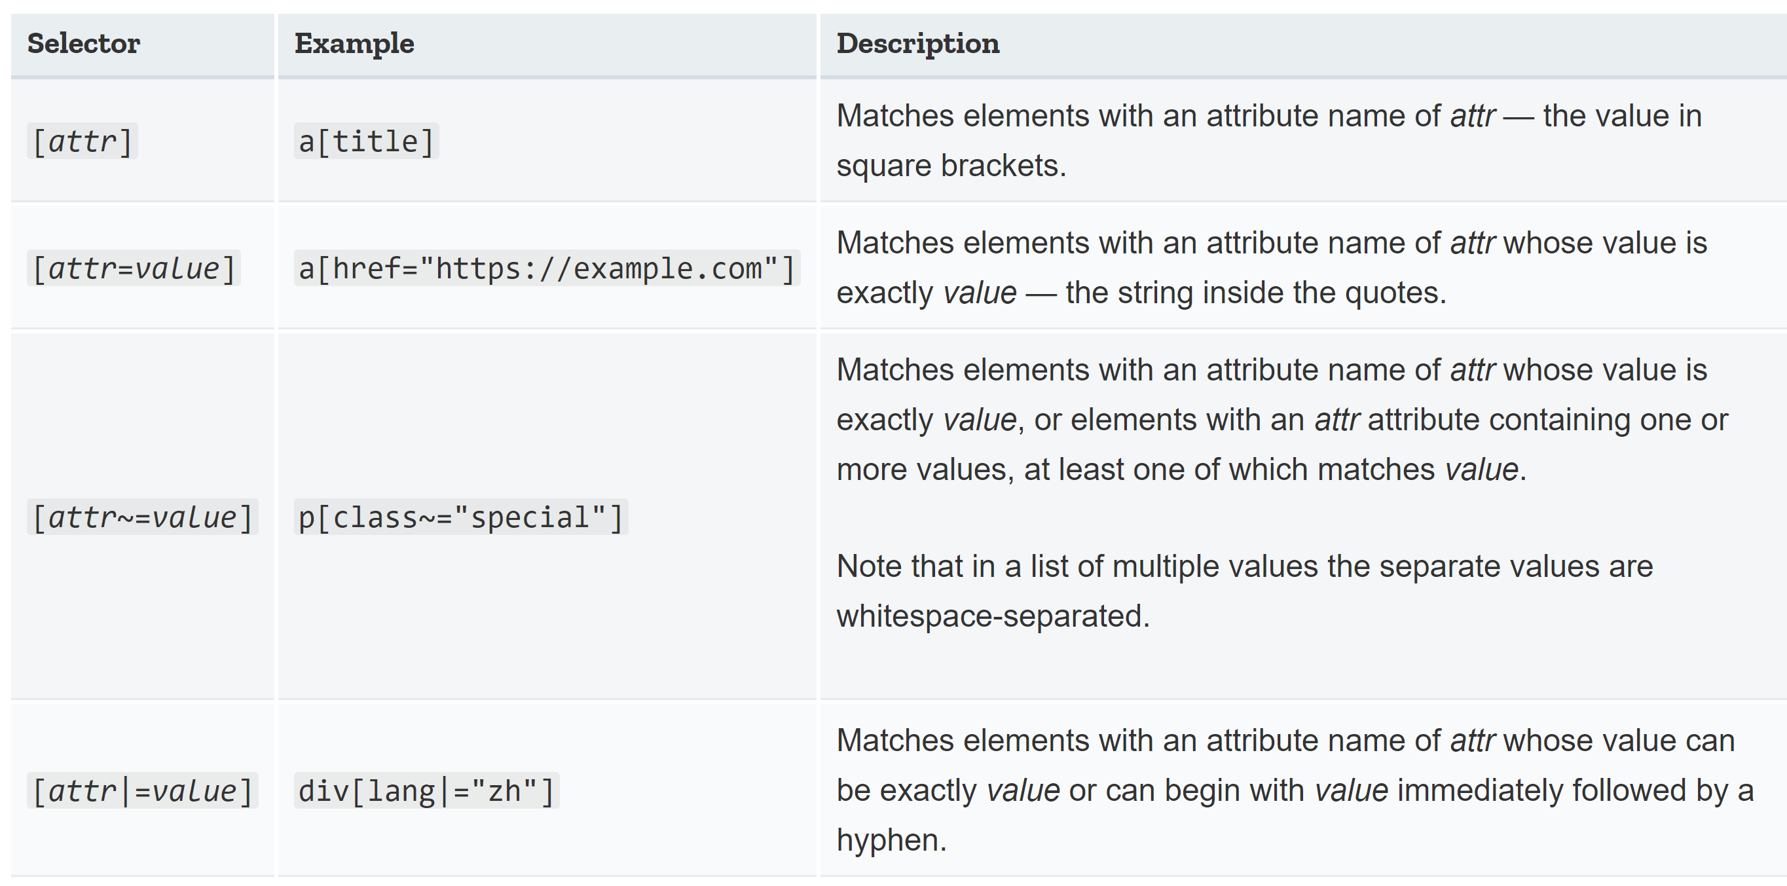
Presence and Value Selector
These selectors enable the selection of an element based on the presence of an attribute alone (for example href), or on various different matches against the value of the attribute.

Slide 24
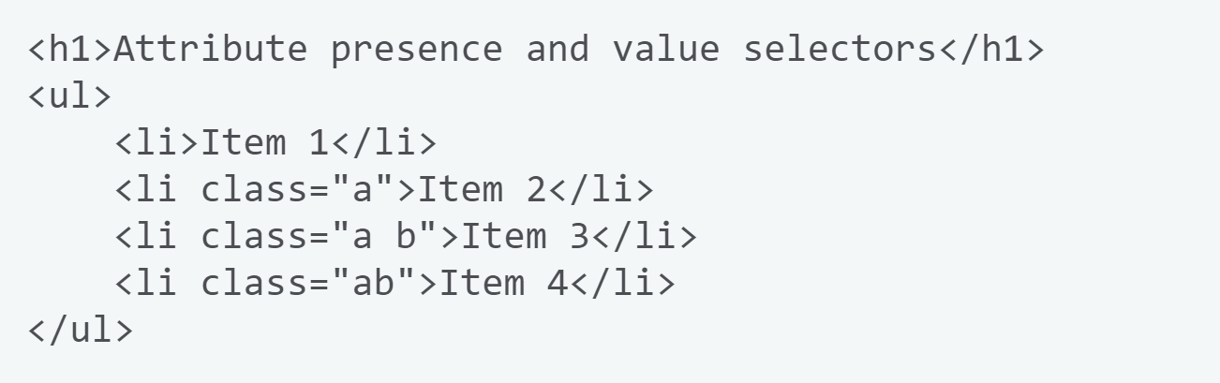
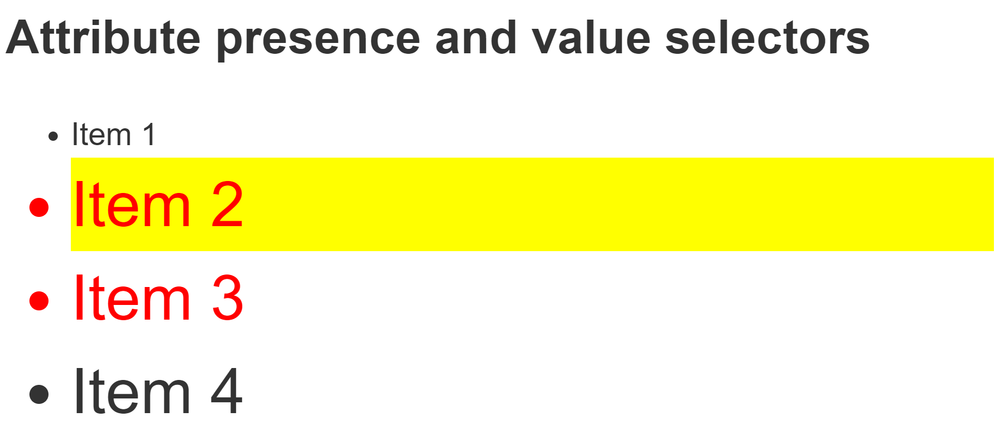
Presence and Value Selector
Example:

Slide 25
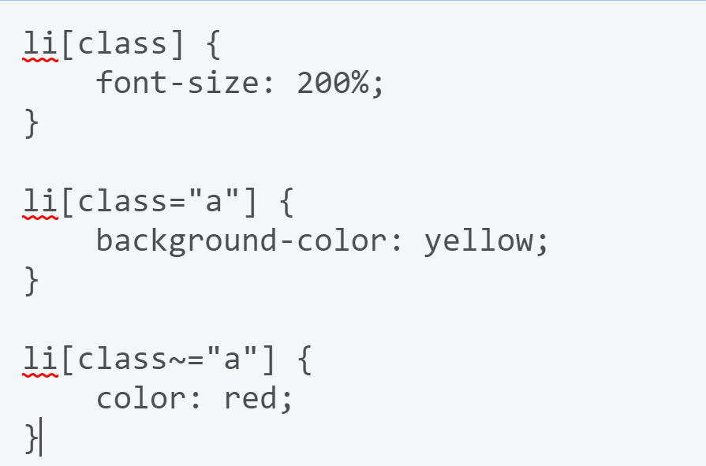
Presence and Value Selector
Example:

Slide 26
Presence and Value Selector
Example:

Slide 27
Presence and Value Selector
By using li[class] we can match any selector with a class attribute. This matches all but the first list item.
li[class="a"] matches a selector with a class of a, but not a selector with a class of a with another space-separated class as part of the value.
It selects the second list item.
li[class~="a"] will match a class of a but also a value that contains the class of a as part of a whitespace-separated list. It selects the second and third list items.

Slide 28
Presence and Value Selector
Example:

Slide 29
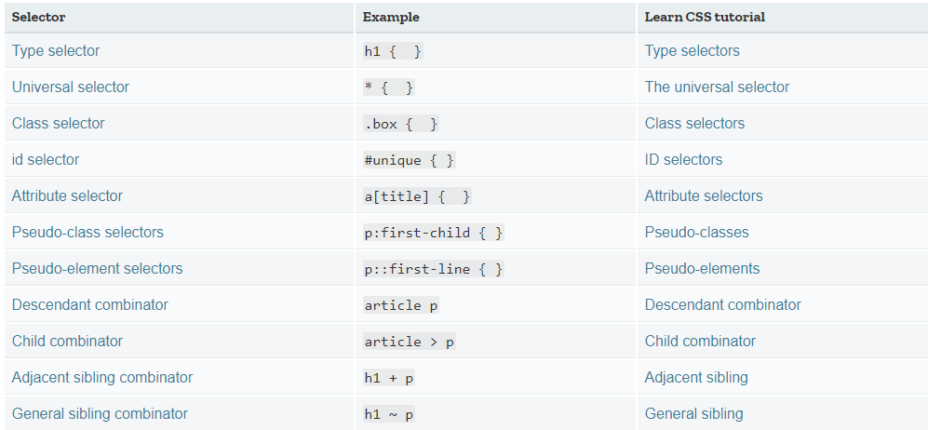
Selectors
Summary of selectors

Slide 30
Questions

